Slide 1
Satellite Project - Introduction
Downloading the dataset (Satellite images) from Google Earth Engine
Cleaning and Processing the dataset
Defining the Target
Defining the Model
Next Steps

Slide 2
Downloading the dataset (Satellite images) from Google Earth Engine
Download Dataset via Google Earth Engine (https://code.earthengine.google.com)
Parameters to be changed in the script while downloading the images at village level
State (Since we have village level shape files of 6 states, the values for state can be Karnataka, Bihar, Maharashtra, Kerala, Orissa, Gujrat)
Satellite (Landsat 8 [present from April 2013 onwards], Landsat 7, Sentinel 2) – Satellite images are present at different resolutions
Time Period (Indian Census was done in 2011, so we try to extract the data around the same period)
Bands to be downloaded (We have till now worked on 3 bands – Red, Blue, Green. Landsat 8 has around 9 more bands including band related to water, vegetation etc.)
Mean/Median of selected images for a time period
Images are downloaded in google drive

Slide 3
Cleaning and Processing the dataset…
The images are downloaded in Google Drive associated with Google Earth Engine account
The space available in the google drive is 15 GB.
Earth Engine breaks the state images into smaller images for handling automatically
For 3 band (RGB) images, for a big state like Karnataka, the partial image size could be ~3-4 GB, So if we download image for a state like Karnataka for 12 Bands, it can be of size ~13-15 GB. Hence, we will have to download images of one state at a time
Data can be downloaded from google drive to HPC via a Python script

Slide 4
…Cleaning and Processing the dataset
Once the data is in HPC, we will break the state level images to village (or district) level images using shape files of villages (or districts)
Shape files tells us about the coordinates associated with a village (or district). Raster io python module will be used to cut out village level images from state level images
We have 3 shape files – xaa.json, xab.json, xac.json which will be used to cut out the images at village level

Slide 5
…Cleaning and Processing the dataset
Once the village level images have been obtained we will remove images which are duplicate (because the most granular level is village-ward combination and we might have some images with same village number) and those images for which we do not have the village labels
we will break the images data into train and test set
For each socio-economic indicator, we will do the following
Distribute all the village images according to the label of the corresponding village – For ex. For BF, out of ~170k images, 110k belong to class 1, 30k belong to class 2 and remaining to class 3
Since the overall dataset has class imbalance, We will maintain same class imbalance in train and test data sets as well.
For our case, for images having label 1, 80% will be train data and 20% will be test data. Similarly for label2 and 3

Slide 6
Defining the Target (Both at Village and District Level)
We are trying to solve a classification problem. We will be predicting the labels of different socio-economic indicators, which are
Bathroom Facility (BF)
Fuel for Cooking (FC)
Employment (EMP)
Main Source of Water (MSW)
Main Source of Light (MSL)
Assets
Each indicator has 3 levels – Level 0, Level 1, Level 2
Level 0 is the least developed (except in case of EMP), while level 2 is most developed (except in case of EMP)
Hence, we need a model which could predict, given the village image, for a particular socio-economic indicator, what is the label (0,1 or 2). There will be 6 such models (one for each indicator)

Slide 7
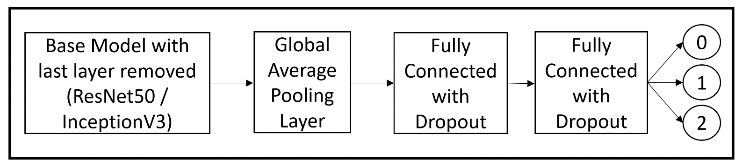
Defining the Model – Village Level
Since we are using images, we will be using deep learning models pre-trained on Imagenet dataset with slight modifications.
Since a DL model requires constant image size and since village image sizes vary according to shape of the images, we will zero pad small images and crop large images. This will be done on the flow while we load batch of images for training or testing. Presently we are giving 224 x 224 images to DL model
We have used ResNet18 and InceptionV3 present in Keras library in Python. We have added few more layers after these standard architectures. We have followed a Transfer Learning followed by a Fine Tuning approach. Below is the model architecture

Slide 8
Next Steps – Village Level
Changing Input Image size – presently giving 224x224, we can change this to maybe 64x64. We noticed that most of the villages have small size and hence most the images could have been black because of zero padding
Using all 9-10 bands – presently using only 3 bands (RGB). We can either modify model architecture (there’s paper on this) to incorporate 12 bands or combine all bands and PCA reduce all 12-13 bands to 3 bands and then give input to model
We can use different models such as Xception and other latest ones
We are treating the problem as a classification problem. Essentially labels of socio-economic indicators were generated using k-means clustering. Using regression values, we predicted the class of label and then used classes as ground truth for DL models. We can instead treat the problem as a regression problem and try and predict the regression labels instead
We can use other satellite data – for example of Sentinel 2
Right now, our best results are on Landsat 8, which is from 2013 onwards while the census is of 2011. Sir suggested to use mean of 2010, 2011, 2012 Landsat 7 images instead of Landsat 8

Slide 9
Defining the Model – District Level
500 m resolution Landsat 7 images were downloaded using GEE for all bands
A Coarse Machine Learning model was built using the following 3 kinds of features were made. The 3rd method was reported in the final paper
The sum of pixels to be taken as features (11 length feature vector corresponding to 11 bands)
The average of pixels to be taken as features (11 length feature vector corresponding to 11 bands)
Feature made by counting number of pixels in bins, just like a histogram (bins were decided using scikit learn quantile package)

Slide 10
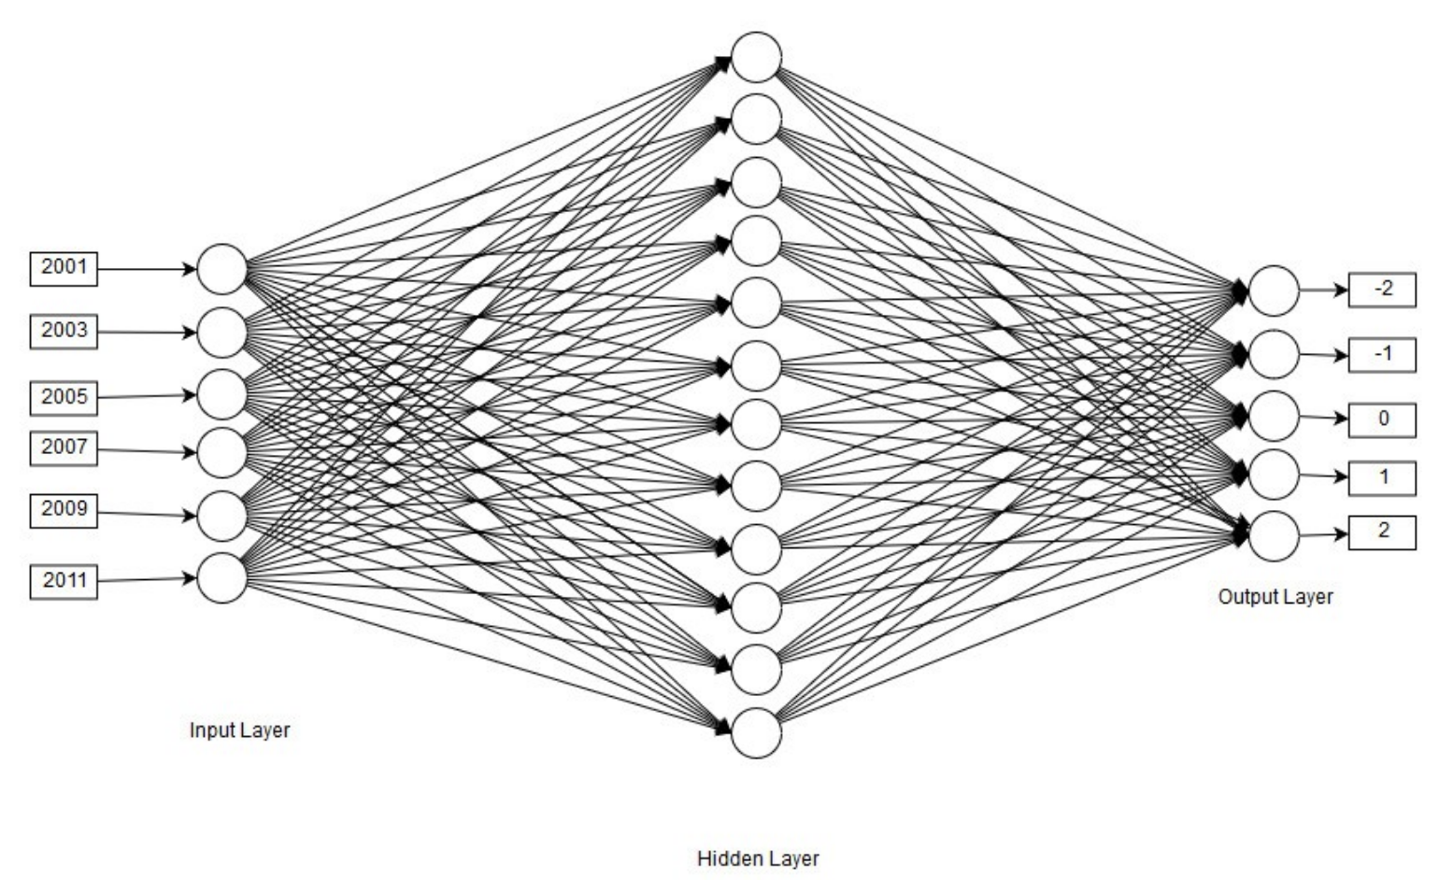
Temporal Analysis – District Level
Once model was made at district level using 2011 images, it was used to predict results for 2001 since we had ground truth at 2001
After that, for years 2001, 2003, 2005, 2007, 2009, 2011 similar predictions were made using model trained on 2011. These 6 inputs were then fed to a Change Classifier (Neural Net) to predict change from 2011 to 2001 (2011-2001) [Total 592 districts]

Slide 11
Next Steps – District Level
Can try training on Sentinel 2 or Landsat 8, as compared to Landsat 7 500m images
Can try creating other types of features

